Slide 1

Automating FreeBSD Jails
Using IOCage and SaltStack

Slide 2
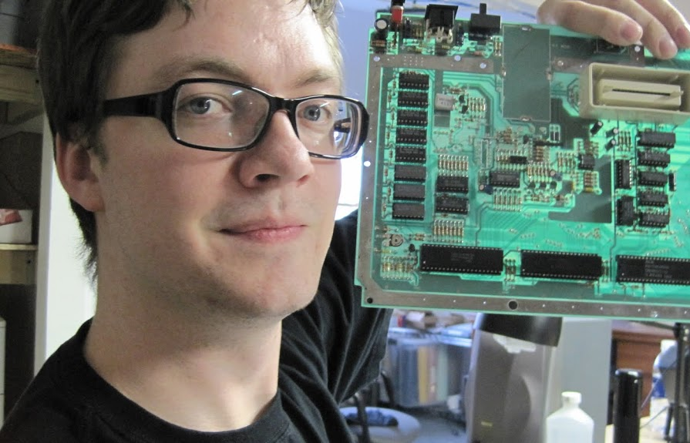

Who?
d3c4f
Systems Admin / DevOps
Software Developer
PortAParty Co-Creator
theTransistor Founder
OpenWest Core Team
BlackHat Volunteer
Caffeine Addict
Electronic Badge Designer
Yukaia
Systems Administrator
Automobile Enthusiast
PortAParty Co-Creator
theTransistor Founder
OpenWest Core Team
Blackhat Volunteer
Dr.Pepper Connoisseur
Hardware / Server Nerd

Slide 3
Contact Info>
d3c4f@sausage.land
yukaia@sausage.land

Slide 4
What will we be talking about today?
FreeBSD Jails (via iocage)
SaltStack Basics
Using SaltStack with FreeBSD Jails

Slide 5
FreeBSD Jails - What are these things?

Slide 6
FreeBSD Jails - What are these things?
FreeBSD Jails are an implementation of OS-Level Virtualization.
They serve the need to establish separation between services, mainly for security and ease of administration.

Slide 7
FreeBSD Jails - What are these things?
FreeBSD Jails are an implementation of OS-Level Virtualization.
They serve the need to establish separation between services, mainly for security and ease of administration.
Virtualization
Each jail is a virtual environment with its own files, processes, and user accounts.
Security
Each jail provides controls to separate it from the host system and any other jails.
Ease of Delegation
Jails allow delegation of tasks that require SU access without handing over complete control of the system.

Slide 8
FreeBSD Jails - What is iocage?

Slide 9
FreeBSD Jails - What is iocage?
“iocage is a zero dependency drop in jail/container manager amalgamating some of the best features and technologies FreeBSD operating system has to offer. It is geared for ease of use with a simple and easy to understand command syntax.”

Slide 10
FreeBSD Jails - What is iocage? (Features)
Utilizes ZFS for Jail Datasets and Snapshot Management
Templates, Clones, BaseJails, and Fully Indepentent Jails
Virtual networking stacks (vnet)
Shared IP based jails (non-vnet)
Resource Limits (CPU, RAM, FileSystem Quotas, etc)
Binary Updates
Export and Import

Slide 11
FreeBSD Jails - Manual Setup

Slide 12
FreeBSD Jails - Manual Setup
Install FreeBSD with ZFS for Jails (We’ll use ZFS on root)

Slide 13
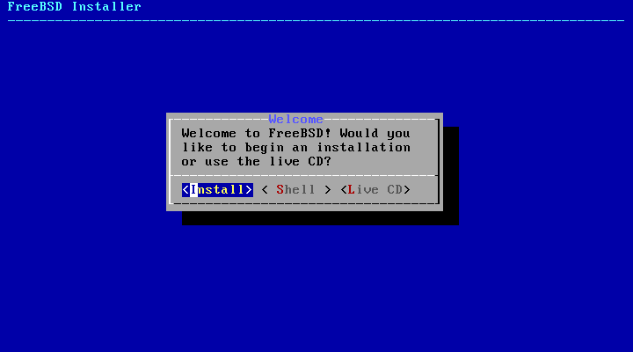
FreeBSD Jails - Manual Setup

Slide 14
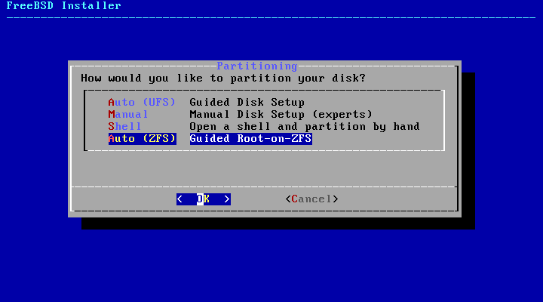
FreeBSD Jails - Manual Setup

Slide 15

FreeBSD Jails - Manual Setup

Slide 16
FreeBSD Jails - Manual Setup
Install FreeBSD with ZFS for Jails (We’ll use ZFS on root)
Install iocage

Slide 17
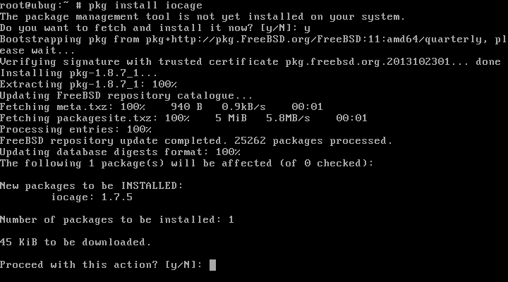
FreeBSD Jails - Manual Setup

Slide 18
FreeBSD Jails - Manual Setup
Install FreeBSD with ZFS for Jails (We’ll use ZFS on root)
Install iocage
Fetch a release

Slide 19
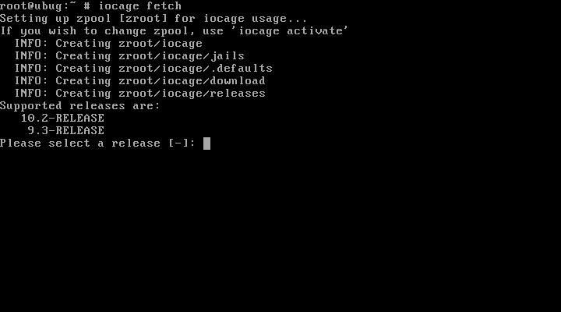
FreeBSD Jails - Manual Setup

Slide 20
FreeBSD Jails - Manual Setup
Install FreeBSD with ZFS for Jails (We’ll use ZFS on root)
Install iocage
Fetch a release
Create a Jail

Slide 21
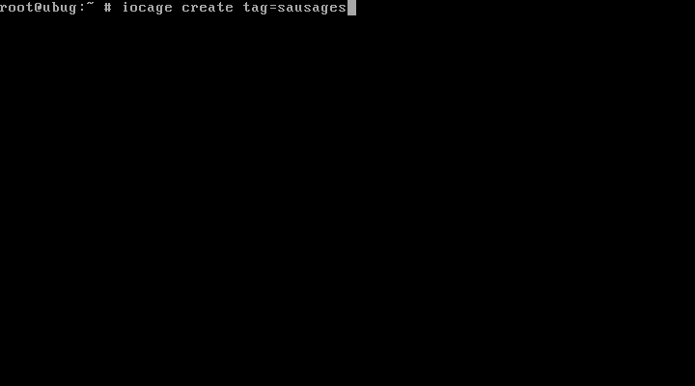
FreeBSD Jails - Manual Setup

Slide 22
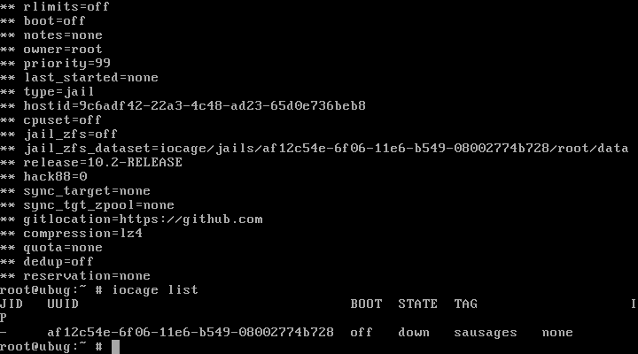
FreeBSD Jails - Manual Setup

Slide 23
FreeBSD Jails - Manual Setup
Install FreeBSD with ZFS for Jails (We’ll use ZFS on root)
Install iocage
Fetch a release
Create a Jail
Start a Jail

Slide 24
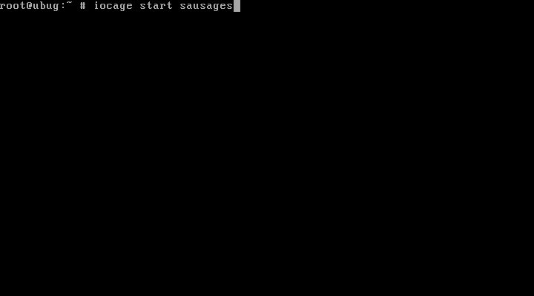
FreeBSD Jails - Manual Setup

Slide 25
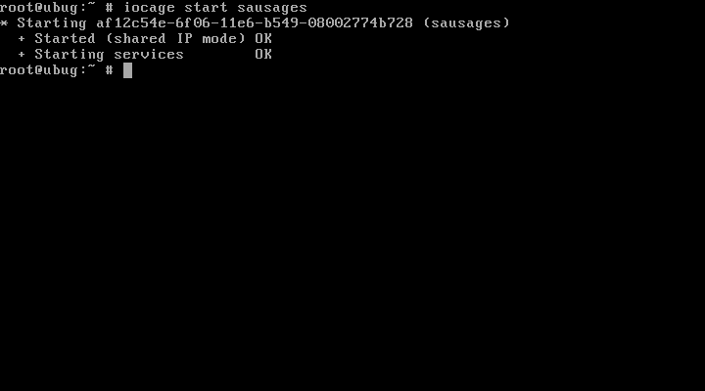
FreeBSD Jails - Manual Setup

Slide 26
FreeBSD Jails - Manual Setup
Install FreeBSD with ZFS for Jails (We’ll use ZFS on root)
Install iocage
Fetch a release
Create a Jail
Start a Jail
Autostart Jails
Add “iocage_enable=YES” to /etc/rc.conf
Run: iocage set boot=on UUID|TAG
Ex: iocage set boot=on sausages
Console into a Jail

Slide 27
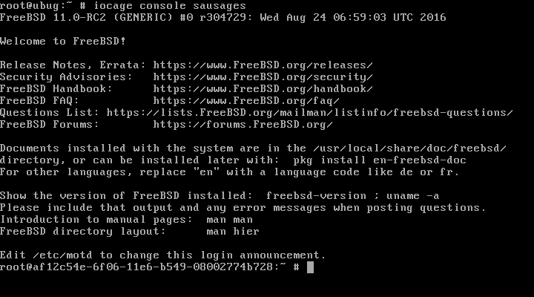
FreeBSD Jails - Manual Setup

Slide 28
FreeBSD Jails - Manual Setup
Install FreeBSD with ZFS for Jails (We’ll use ZFS on root)
Install iocage
Fetch a release
Create a Jail
Start a Jail
Autostart Jails
Add “iocage_enable=YES” to /etc/rc.conf
Run: iocage set boot=on UUID|TAG
Ex: iocage set boot=on sausages
Console into a Jail
Destroy a Jail

Slide 29
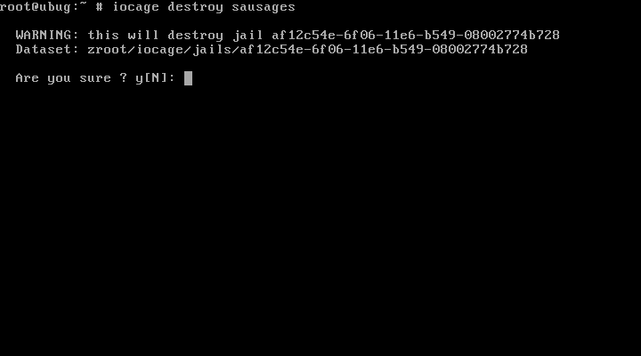
FreeBSD Jails - Manual Setup

Slide 30


Slide 31
SaltStack - What is SaltStack?

Slide 32
SaltStack - What is SaltStack?
“a Python-based open-source configuration management software and remote execution engine”

Slide 33
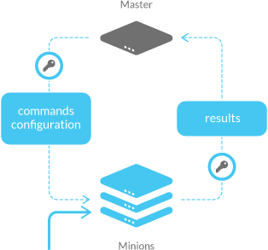
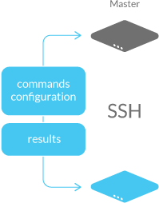
SaltStack - What is SaltStack?

Slide 34
SaltStack - Who is using SaltStack?

Slide 35
SaltStack - Who is using SaltStack?
Rackspace - https://developer.rackspace.com/blog/why-i-use-saltstack/
EMC - https://youtu.be/UalzJq40xMk
Google Kubernetes
Zillow
Photobucket
CloudFlare
Linkedin
Hulu
HP Cloud Services
DoD
...

Slide 36
SaltStack - Quick overview of the basic components

Slide 37
SaltStack - Quick overview of the basic components
Master
Used to send commands and configurations to the Minions.
Common to run with a single master, even in large environments.
Contains:
State Files
Top Files
Formulas
Pillars
Execution Modules
… & more

Slide 38
SaltStack - Quick overview of the basic components
Master (sends commands, stores config stuffs)
Minion
A system that is managed by the Master AND running the salt-minion service.
Receives commands and configurations from the Master.
Contains:
A running salt-minion service
Grains
Bits of information about the System that the salt-minion is running on
Returns information about requested command or configuration execution, or grain information.

Slide 39
SaltStack - Quick overview of the basic components
Master (sends commands, stores config stuffs)
Minion (receives and executes commands, configurations)
Modules
Small programs or scripts that are copied to the Minions from the Master
Distributed when “state.apply” is run, or when sync functions are executed.
Ran when requested by the master
Return information about execution in a (semi)standard format

Slide 40
SaltStack - Quick overview of the basic components
Master (sends commands, stores config stuffs)
Minion (receives and executes commands, configurations)
Modules (small programs, executed on the Minions)
Formulas aka States
Actual written representation of a System's Configuration
Entry point begins with “top.sls”
Files end with “.sls”
Used to match Configurations to Minions in a variety of ways

Slide 41
SaltStack - Quick overview of the basic components
Master (sends commands, stores config stuffs)
Minion (receives and executes commands, configurations)
Modules (small programs, executed on the Minions)
Formulas aka States (System Configurations)
Grains
Information about each minion (OS, Memory, CPU, etc)
Many pre-defined Grains
You can create any custom entry for each system as well
Stored on the Minion

Slide 42
SaltStack - Quick overview of the basic components
Master (sends commands, stores config stuffs)
Minion (receives and executes commands, configurations)
Modules (small programs, executed on the Minions)
Formulas aka States (System Configurations)
Grains (Minion Information)
Pillars
Stored Securely on the Master (not shared with Minions, unless explicitly asked)
User-Defined
Used to store information such as
Ports, File Paths, Configuration Parameters, Passwords, Keys, etc.

Slide 43
SaltStack - Quick overview of the basic components
Master (sends commands, stores config stuffs)
Minion (receives and executes commands, configurations)
Modules (small programs, executed on the Minions)
Formulas aka States (System Configurations)
Grains (Minion Information)
Pillars (Secure Information)
… and lots more.

Slide 44
SaltStack - Demo Time!

Slide 45
SaltStack - Demo Time!
Following Guide: https://docs.saltstack.com/en/getstarted/fundamentals/

Slide 46
SaltStack - Demo Time!
Following Guide: https://docs.saltstack.com/en/getstarted/fundamentals/
Spin up VirtualBox / Vagrant Demo

Slide 47
SaltStack - Demo Time!
Following Guide: https://docs.saltstack.com/en/getstarted/fundamentals/
Spin up VirtualBox / Vagrant Demo
View Keys

Slide 48
SaltStack - Demo Time!
Following Guide: https://docs.saltstack.com/en/getstarted/fundamentals/
Spin up VirtualBox / Vagrant Demo
View Keys
Send a command(s) and get data back
Get data back in misc formats (--out=[json|raw|txt|yaml|highstate|grains]

Slide 49
SaltStack - Demo Time!
Following Guide: https://docs.saltstack.com/en/getstarted/fundamentals/
Spin up VirtualBox / Vagrant Demo
View Keys
Send a command(s) and get data back
Get data back in misc formats (--out=[json|raw|txt|yaml|highstate|grains]
Targeting

Slide 50
SaltStack - Demo Time!
Following Guide: https://docs.saltstack.com/en/getstarted/fundamentals/
Spin up VirtualBox / Vagrant Demo
View Keys
Send a command(s) and get data back
Get data back in misc formats (--out=[json|raw|txt|yaml|highstate|grains]
Targeting
States

Slide 51
SaltStack - Demo Time!
Following Guide: https://docs.saltstack.com/en/getstarted/fundamentals/
Spin up VirtualBox / Vagrant Demo
View Keys
Send a command(s) and get data back
Get data back in misc formats (--out=[json|raw|txt|yaml|highstate|grains]
Targeting
States
Top File

Slide 52
SaltStack - Demo Time!
Following Guide: https://docs.saltstack.com/en/getstarted/fundamentals/
Spin up VirtualBox / Vagrant Demo
View Keys
Send a command(s) and get data back
Get data back in misc formats (--out=[json|raw|txt|yaml|highstate|grains]
Targeting
States
Top File
Another day
Functions, Pillars, Includes, Jinja, File Management, Salt-Cloud, etc.

Slide 53
TIME TO COMBINE!

Slide 54


Slide 55
iocage + salt : Ingredients

Slide 56
iocage + salt : Ingredients
FreeBSD
ZFS
iocage
salt
Iocage Formula for SaltStack
https://github.com/bougie/salt-iocage-formula

Slide 57
iocage + salt : Installation
Install Salt and Git
pkg install py27-salt git
Clone the salt-iocage-formula repository to /usr/local/etc/salt
cd /usr/local/etc/salt/
git clone https://github.com/bougie/salt-iocage-formula.git

Slide 58
iocage + salt : Configuration
Configure Salt-Master
We’ll use the Base System, but this could easily be another system, or even a jail.
Set up the master config
cp /usr/local/etc/salt/master.sample /usr/local/etc/salt/master
vim /usr/local/etc/salt/master
Configure file_roots, pillar_roots, etc (point to cloned repo for this example)
Enable the SaltStack binary builds, edit /usr/local/etc/pkg/repos/saltstack.conf
See: https://docs.saltstack.com/en/latest/topics/installation/freebsd.html
Enable the Master in /etc/rc.conf
sysrc salt_master_enable=”yes”
Start the salt_master service
service salt_master start

Slide 59
iocage + salt : Create a Jail
salt-call --local saltutils.sync_all
salt-call --local iocage.fetch
salt-call --local iocage.list_jails
salt-call --local iocage.create full tag=sausages release=10.3-RELEASE
salt-call --local iocage.start sausages
salt-call --local iocage.stop sausages
salt-call --local iocage.destroy sausages (NEED TO TYPE ‘Y’ + ENTER)

